Slide 1
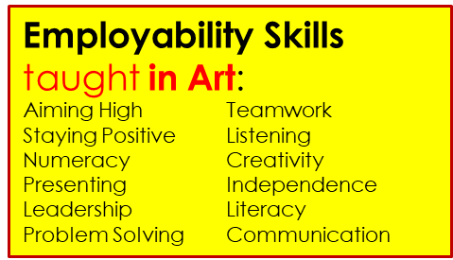
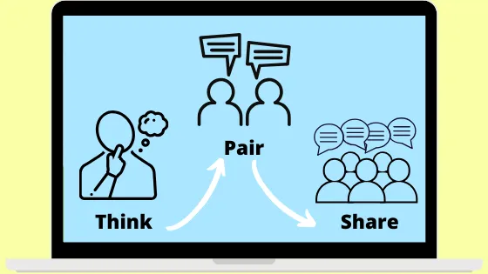
Stowmarket High School
Art Learning Journey
College Interview
Celebration Summer Exhibition
KS5 Application
Exam results
A & T Levels
Futures & Careers
Advice
Foundation or Degree Course
Portfolio Preparation
BTEC and
Aapprenticeships
Moderation Exhibition
Pre Public Exam
‘INSIDE,
OUTSIDE’
Completion of
Coursework
Contextual
Research
Digital Manipulation and Experimentation
Contextual Analysis
Digital
Development
Observational Drawing
2D & 3D form
Interventions &
Catch Ups
1:1 Feedback
Artist
Research
HWK
‘INTRODUCTION &
EXPECTATIONS’
Observational Drawing
‘Exam’
HWK
HWK
HWK
HWK
Futures
Exam Preparation Workshops
Media Experimentation
External Exam Preparation
Ideas Development
Gallery
Visit
Contextual Analysis
Media Experimentation
11
Assessment. Group & 1:1 Feedback
Museum
Visit
Photography
Summer Exam
Indpendent Project
Communicating in Art & Contextual Analysis
Visual Recording
& Written Analysis
Digital
Development
Observational Drawing
Painting
Paper Collage
HWK
Ideas Development
Photography
Photography
Composition
Portraiture
1:1 Feedback
‘NATURAL FORM’
Artist
Research
Futures
HWK
HWK
HWK
Futures
HWK
HWK
Media Experimentation
‘SHAPE &
FORM’
HWK
‘INTRODUCTION &
EXPECTATIONS’
Photography
Artist
Research
Textiles
Digital Manipulation and Experimentation
GCSE
Educational
Visit
Contextual
Research
Exam Preparation
Independent Outcome
10
Observational Drawing
‘IDENTITY’
Photography
Media Experimentation
1:1 Feedback
HWK
Experimental Drawing
Mono
Printing
Contextual
Research
Surface,
Impasto & Washes
Ellipses
& Parallel Lines
‘STILL
LIFE’
Verbal
Analysis
Communicating
with Art
& Contextual Analysis
Visual Recording
&
Written Analysis
1:1 Feedback
3D Construction
Painting
Written
Analysis
GCSE
Educational
Visit
GCSE Option
Educational
Visit
HWK
CHOOSE Art/Photography : GCSE OPTIONS
HWK
Futures
HWK
HWK
‘Applying
THE
VISUAL ELEMENTS’
Ideas Development
Media Experimentation
Photography
‘LOOK AT ME!’
Printing
Observational Drawing
HWK
Portrait
Drawing
Digital
Development
Artist
Research
Group
Discussion
‘THE
VISUAL ELEMENTS’
Rapid Recap!
‘SHOES’
Illustration
Mixed Media
Painting
Surface,
Impasto & Washes
Card construction & clay modelling
9
‘INTRODUCTION &
EXPECTATIONS’
‘INTRODUCTION &
EXPECTATIONS’
Experimental
Drawing
Artist
Research
Line Drawing
3D Construction
Digital
Development
Teamwork & Resilience
8
HWK
HWK
Futures
HWK
HWK
HWK
Digital
Development
‘Card Structures - 3D Drawing’
Independent Learning
Artist
Research
Symmetry and repeats
Written
Analysis
Mono
Printing
Mono
Printing
HWK
Written
Analysis
‘ENVIRONMENT’
Mono
Printing
‘ABSTRACT’
Symmetry & Asymmetry
Observational Drawing
Tonality
Artist
Research
Artist Research
Printmaking
Written
Analysis
‘TREES’
Colour Theory
‘INTRODUCTION &
EXPECTATIONS’
Peripheral Vision
HWK
7
Experimental Drawing
Futures
HWK
HWK
HWK
HWK
‘Faces & MASKS’
Mixed Media Collage
‘DECORATIVE OBJECT’
Digital
Development
Artist
Research
Verbal
Analysis
‘THE VISUAL ELEMENTS’
Observational Drawing
Painting
Written
Analysis

